Slide 1

Chorus
Version Control for Language Development Teams

Slide 2
Centralized Version Control
CVS, Subversion, Perforce
Must be online
Branching is a “big deal”

Slide 3
Distributed Version Control
Mercurial , Git, Bazaar
Disconnected Sharing
History
Rollback
Branches, merging are the norm

Slide 4
Distributed Version Control
Difficult to
Understand
Configure
Use

Slide 5
So…
Chorus will be built on top of an existing DVCS.
Hide the Complexity
Add the Smarts
Integrate with our Apps

Slide 6
Goals
Infrastructure
USB key
LAN
Internet

Slide 7
Goals
Simple
No “stop and merge”
Zero Configuration
Greedy

Slide 8
Goals
Smart
File type-specific merging
Master copy aware

Slide 9
Goals
Integrated with host applications
App provides
info about files and file types
Conflict-resolution whenever, by whoever
Embeddable UI

Slide 10
Stack
Client Applications (WeSay, FLEx, ?)
SyncManager
UI
DVCS Driver
Mercurial
git
ChorusMerge
3-way Text Merger
3-way XML Merger
(SFM Merger)

Slide 11
Status
Running on top of Mercurial
Tomorrow: Git?
Algorithm
Today: ZeroSum
Later: Partial Merge

Slide 12
Partial merging
Bob
Sally
1
2
branch
a
Surprise!
Partial Merging is hard.
Needs more research (not by me)
b
3
c
4
5
d
e
f
6
6f_{lcd}
6f_{partial}
f_{part}
7
8
g8_{lcd}
g
8_{part}
g6
g8

Slide 13
Zero Sum Merging
One of us loses
Lotus Notes: “replication conflict”
Conflict Event Files

Slide 14
Greedy Syncing
Known Repositories

Slide 15
Master files
Do/don’t merge on sync
If no merge, still pull
Application UI can
show diffs
Facilitated integration into master

Slide 16
Team vs. Individual Files
Team Files:
LIFT
Other
Individual Files
WeSay Configuration
FLEx user preferences
*still in repo

Slide 17
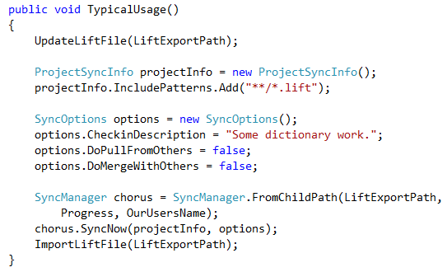
API Ideas

Slide 18
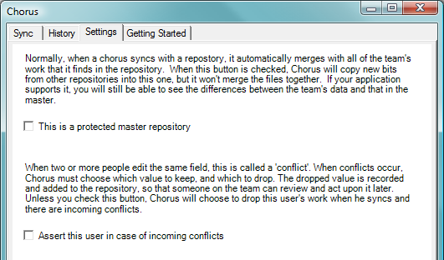
UI Ideas: Settings

Slide 19
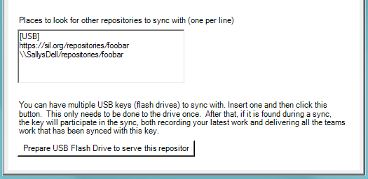
UI Ideas: Settings

Slide 20
Status
XML 3-way Merger working in unit tests
LIFt subclass working
Waiting on LIFt Schema changes: examples, translations, etc.
Further work would be needed for more order-sensitive types.
Working Simulation in Unit tests
Bob & Sally collaborating via USB

Slide 21
Near-term TODOs
Finish API
Finish conflict reporting
Use LIFT spec improvements
Call from WeSay
Call from FLEx
(Get FLEx Lift I/O fast)
Add Chorus DLL to WeSay and FLEx installers
Seek field experimentation

Slide 22
Design ToDos
User names
Q: Order of merging when # users > 2
Names of conflict files
Most UI Design

Slide 23
Longer term ToDos
Chorus
Switch to Git
Master/Satellite workflow
Individual vs. Team files
Partial Merging
Modify another team-member’s files (WeSay)

Slide 24
Longer term ToDos
WeSay
View conflicts
FLEx
View/Resolve conflicts
View Record history
Master review of satellite files
Include more data
Texts
Wordform Inventory

